Slide 1
IoT: Embedded Applications Prototyping with ESP8266 and Arduino Framework
Showcase at Bern Silicon Valley IEVS HackLab Group

Slide 2
Agenda
How it started
Timer – the Enabler for complex Projects
Debug Features needed
Several Projects with common Functions – Skeleton Application

Slide 3
How it started Timer – the Enabler for complex Projects Debug Features needed Several Projects with common Functions – Skeleton Application
History

Slide 4
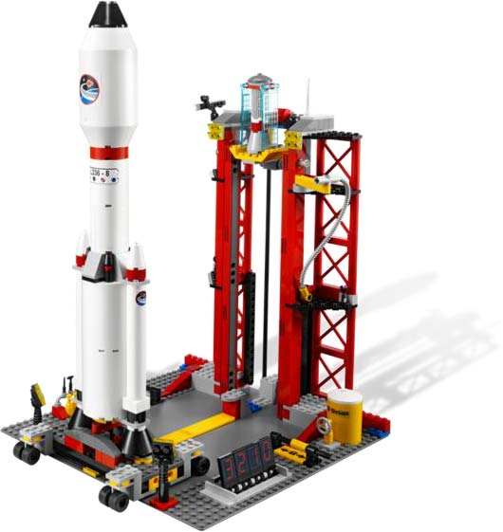
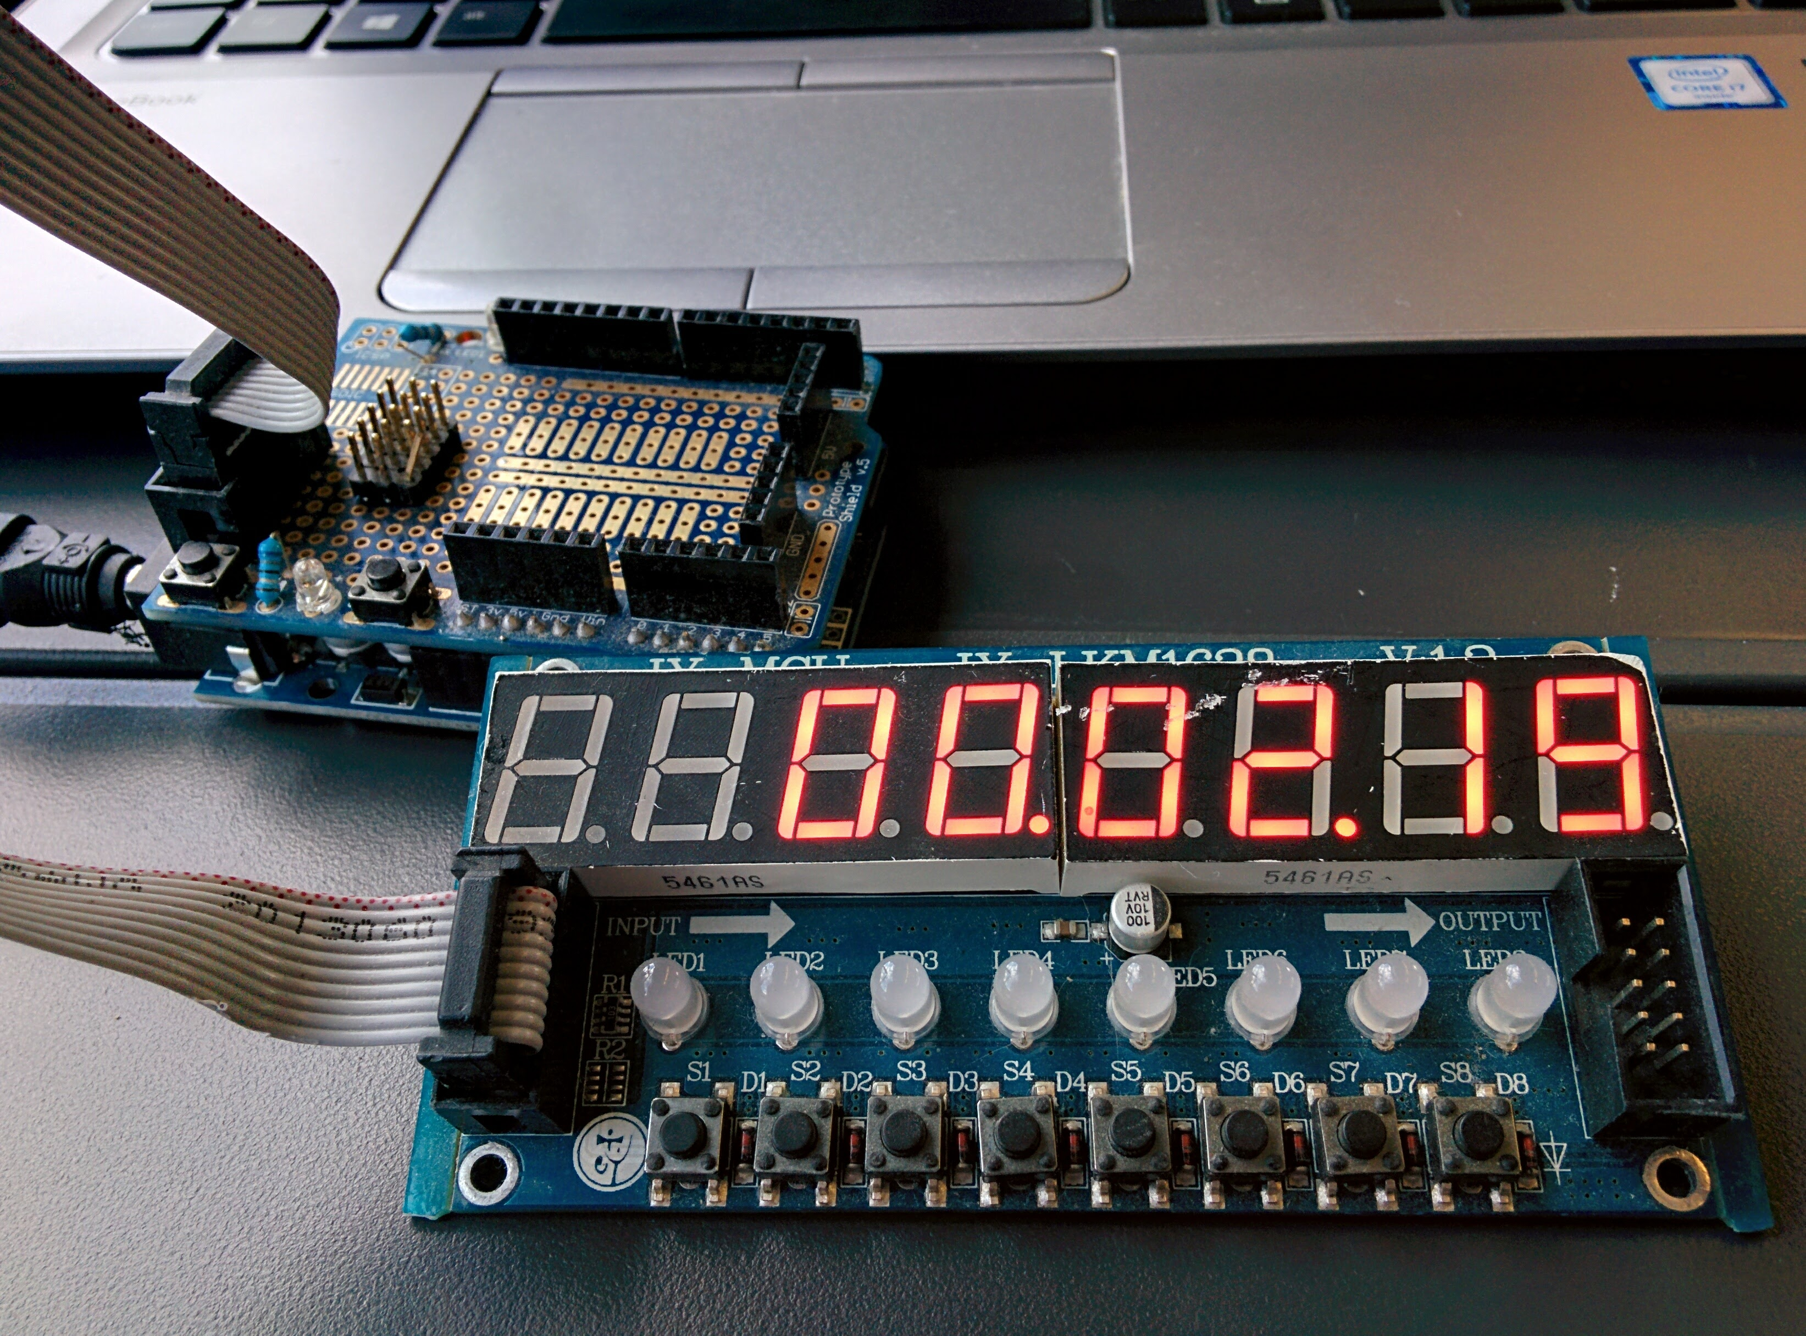
CountDown Watch

Slide 5
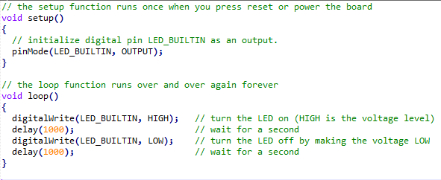
Create a Timing using the Arduino delay() Function
Simple to use
Straight forward
nothing else can be executed in the meanwhile

Slide 6
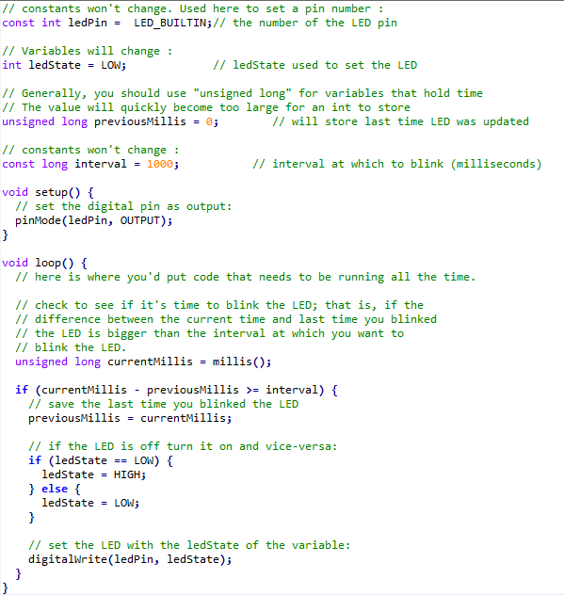
Create a Timing w/o using Arduino delay()
Add multiple if (currentMillis - previousMillis >= interval) { } blocks for any task having a different interval
Brings a lot of Spaghetti code into the loop() function
Result: huge loop() function
https://www.arduino.cc/en/Tutorial/BlinkWithoutDelay

Slide 7

Vision: Encapsulate the Timing Aspect
I’d like to create different independent components
Each of these components shall be responsible for its own timing aspects
Similar to a power transmission system the TimerContext drives all Timer objects evaluating their due times autonomously

Slide 8
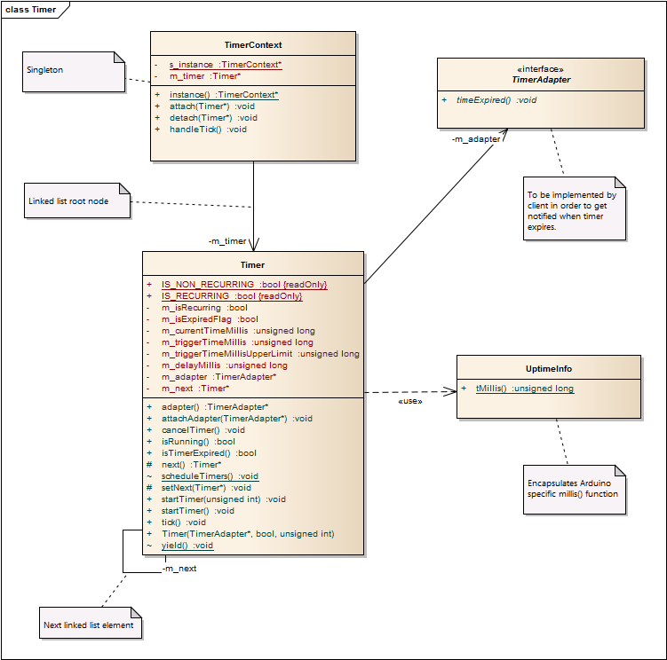
Solution: Timer
Timer
On creation
Have to receive a TimerAdapter implementation as an injected object
attaches itself to TimerContext
Multiple objects are organized in a single linked list
TimerContext
Is a Sigleton, instance always available from everywhere
The «Transmission Wheel» is the handleTick() method which shall be called by the Arduino loop() function
handleTick() then calls tick() on any attached Timer object
https://github.com/dniklaus/arduino-utils-timer

Slide 9
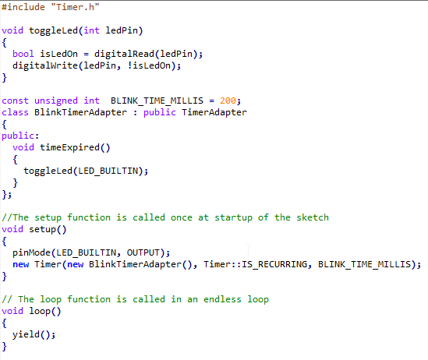
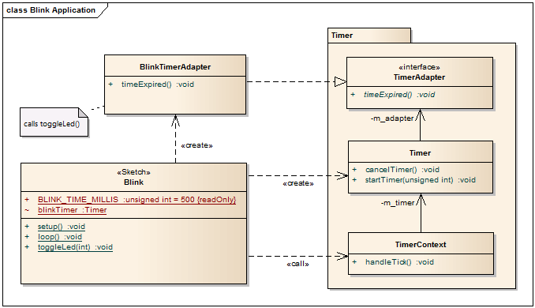
Example: Blink with Timer

Slide 10
How it started Timer – the Enabler for complex Projects Debug Features needed Several Projects with common Functions – Skeleton Application
Easy Prototyping based on the Arduino Framework

Slide 11
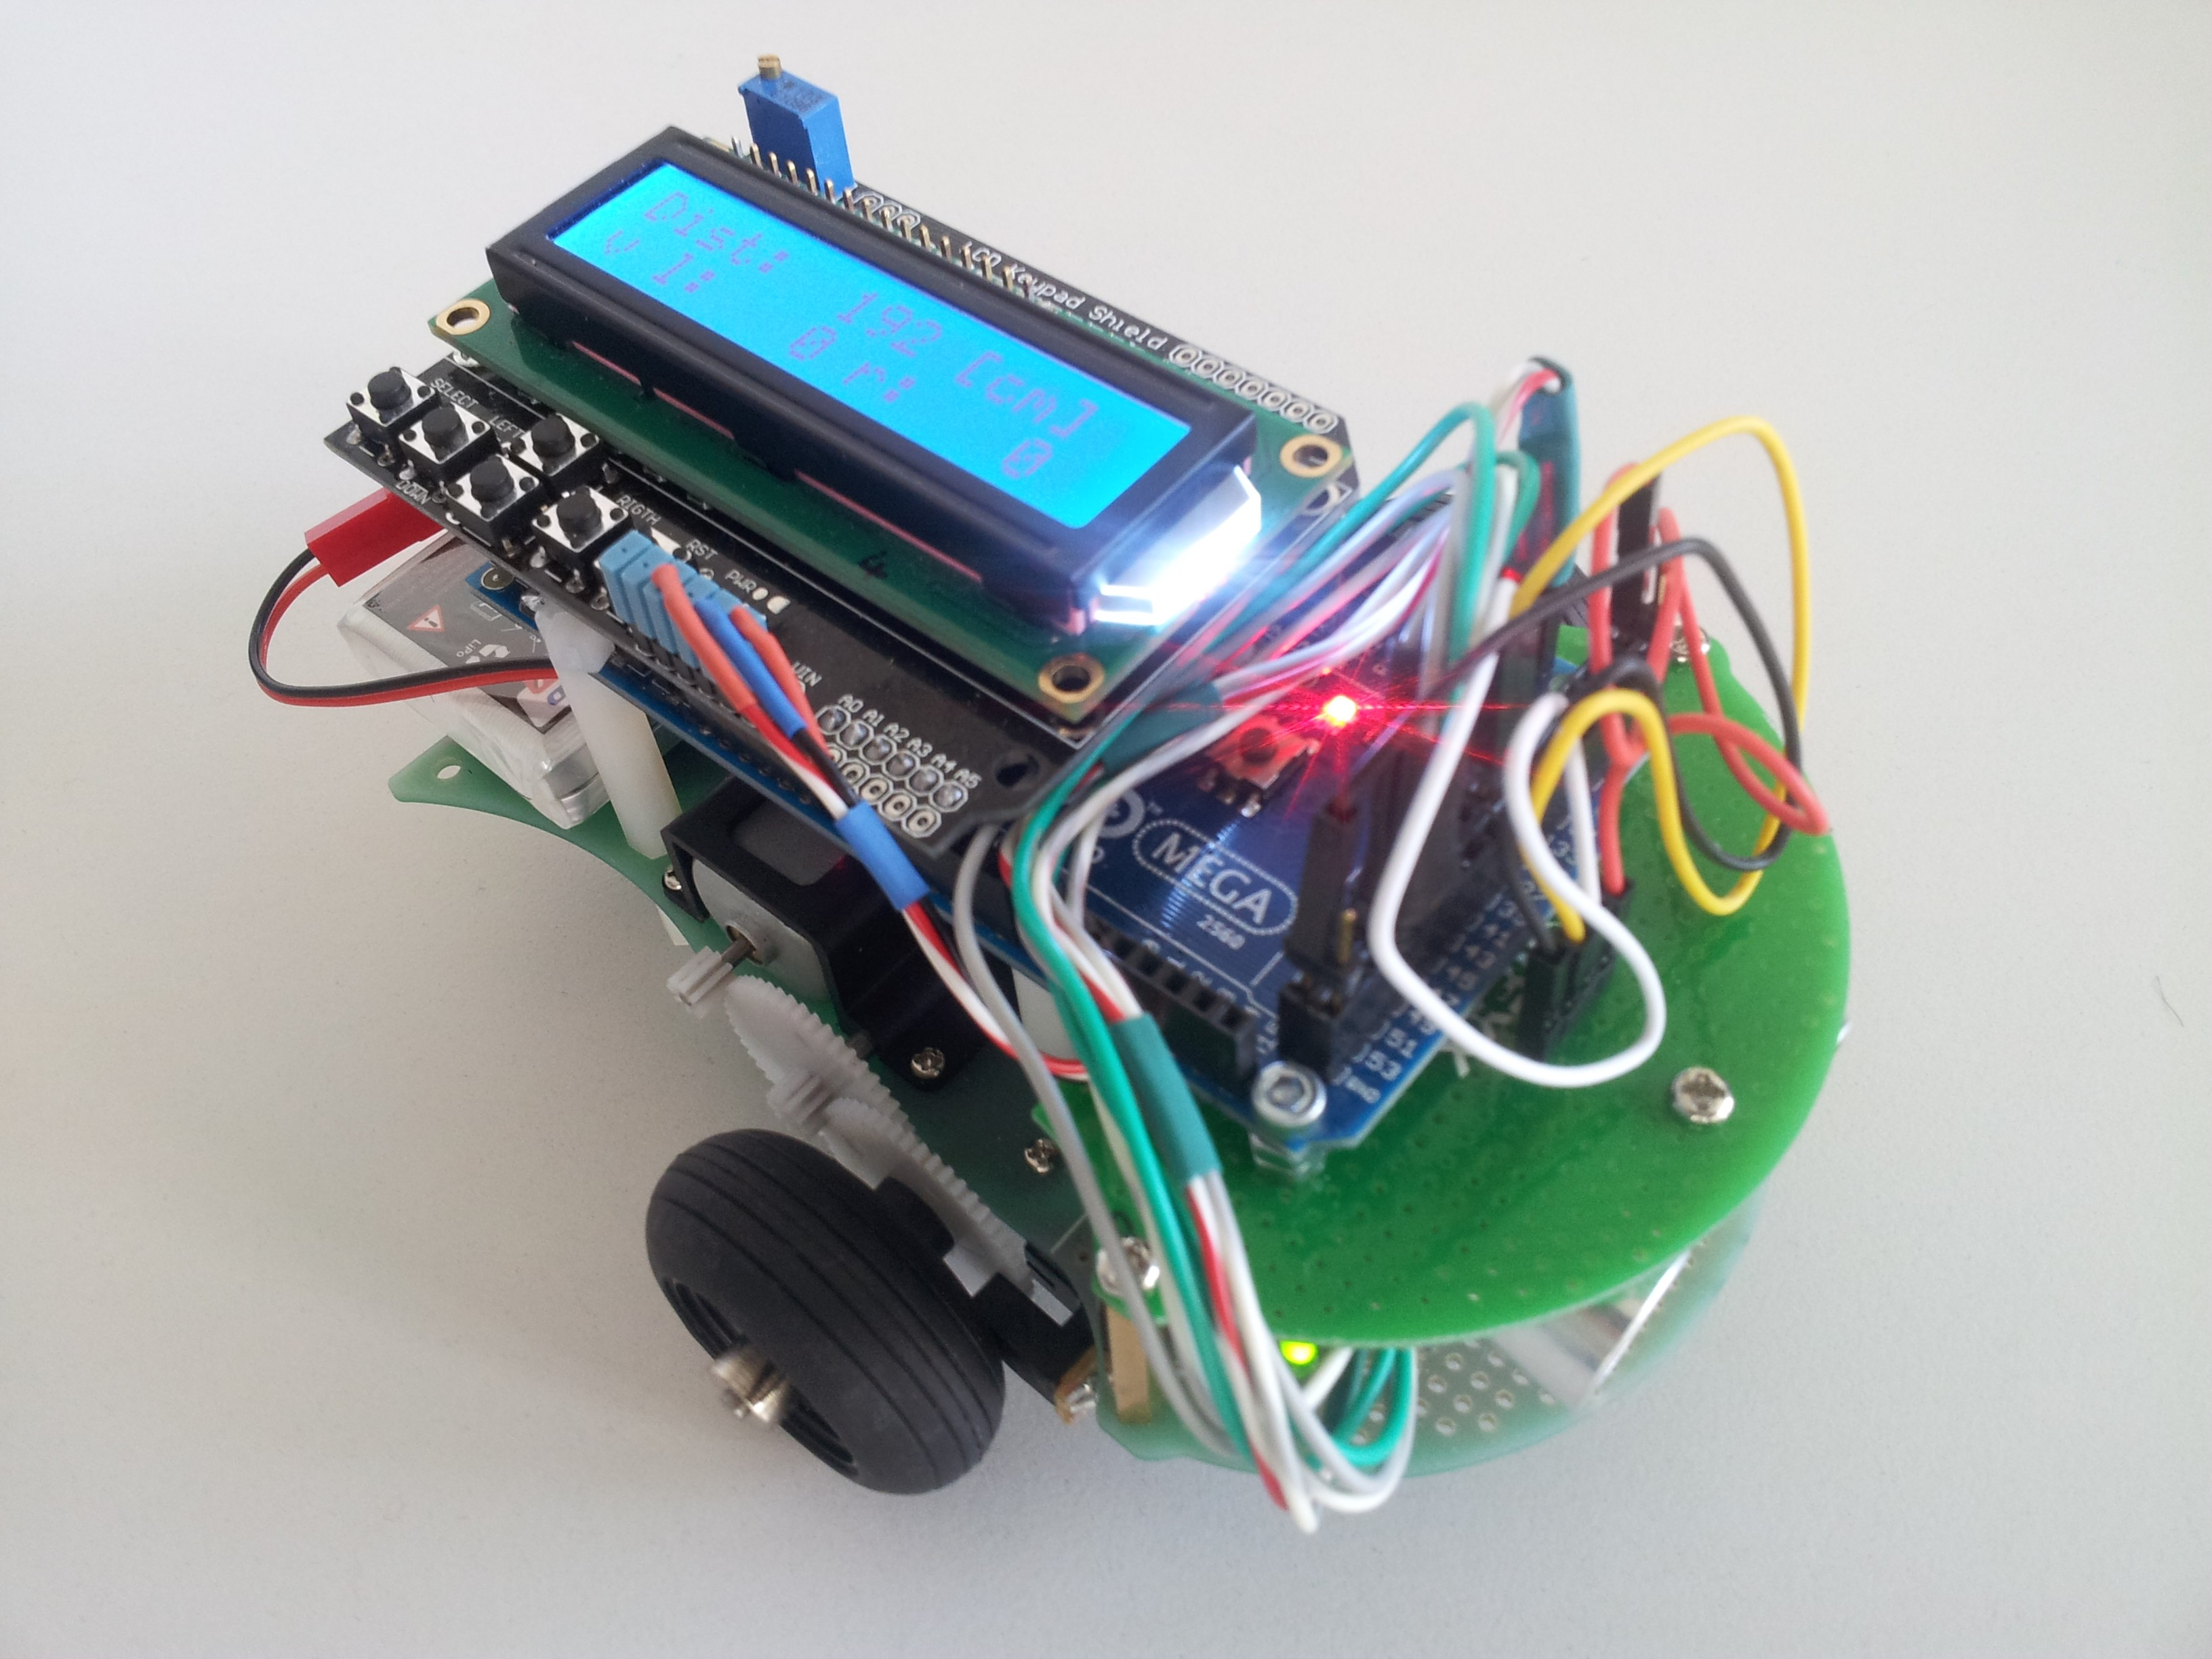
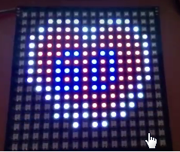
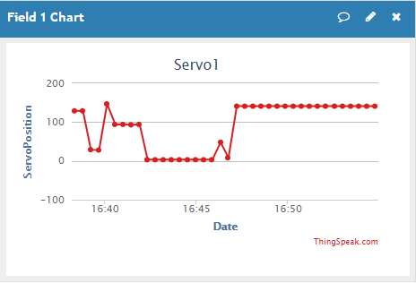
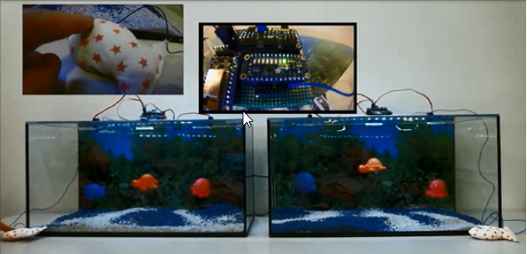
Timer – Enabler for many complex Projects
Countdown Watch
Lintilla Robot (WiFi, RestAPI)
Memphis: Heart rate monitor with animated T-Shirt (HBR sent to ThingSpeak over WiFi)
IoF - Internet of Fish (connected devices, WiFi, MQTT)

Slide 12
How it started Timer – the Enabler for complex Projects Debug Features needed Several Projects with common Functions – Skeleton Application
Debug CLI & Trace components

Slide 13
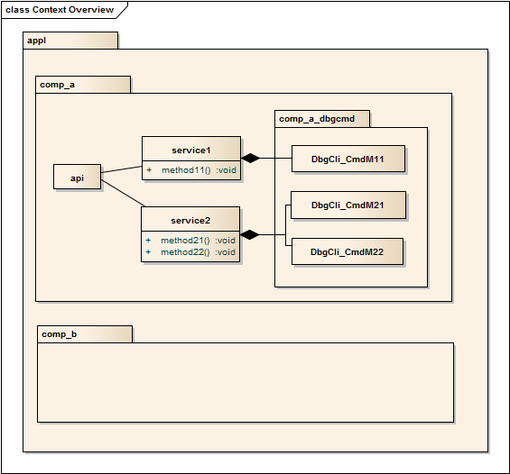
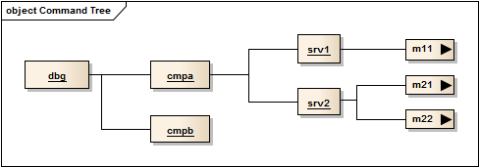
Debug Features – Debug CLI
Functional Features
execute commands entered at a serial console
run specific methods and functions of components within an embedded application
enable to perform automated module integration tests
Design Aspects
represented as classes that can be attached to any component of an embedded application
Build a tree of command tokens

Slide 14
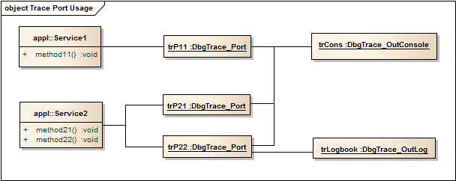
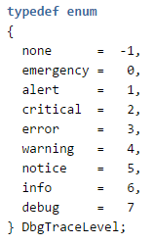
Debug Features – Debug Trace
Functional Features
print out debug and trace log messages trough trace port objects
support different output channels, such as serial console interface or to a log file stored on a compact flash card
trace messages can be filtered according to adjustable trace log levels
Design Aspects
Debug Trace Ports are represented as objects that can be attached to any component of an embedded application
any trace port instance brings the ability to control the filter level using the Debug CLI

Slide 15
How it started Timer – the Enabler for complex Projects Debug Features needed Several Projects with common Functions – Skeleton Application
PlatformIO.org Project with all the libraries, Biolerplate Setup code and interactive Features

Slide 16
IOT Skeleton Application
builds up an Arduino Framework based IoT application skeleton
contains several components helping with debugging and integrating embedded applications on ESP8266 based controller modules
is based on the PlatformIO.org toolchain and thus provide more flexibility to the professional developer (IDE selectable according to personal preferences)
will accelerate the development of new applications for devices
https://github.com/ERNICommunity/wiring-iot-skeleton

Slide 17
IOT Skeleton Application - Components
Timer: configurable recurring or non-recurring timer to schedule events. This component enables to improve your application's architecture by encapsulating the timing functionality into your components and thus make them active
Ramutils: helps to determine the RAM that is currently available
DbgTrace: debug trace log environment with mutable log levels during run time
DbgCLI: interactive console environment with command tree that can be built up decentralized (from any different location in your application code and within any component)
App-Dbg: boilerplate code setting up all the debug environment such as CLI and Tracing and RAM info printer
MqttClient: Mqtt Client wrapping around the 3rd party PubSubClient library, monitoring the LAN and the connection to the MQTT broker, able to automatically re-connect on connection loss, providing auto publish for selectable topics and auto subscribe for all registered topic subscriptions on re-connection, supports multiple subscriptions also with wildcards in the topic path

Slide 18
Thank You!
Dieter Niklaus
Embedded SW Engineer
ERNI Consulting AG, Bern
dieter.niklaus@gmx.net
https://github.com/dniklaus

